Slide 1
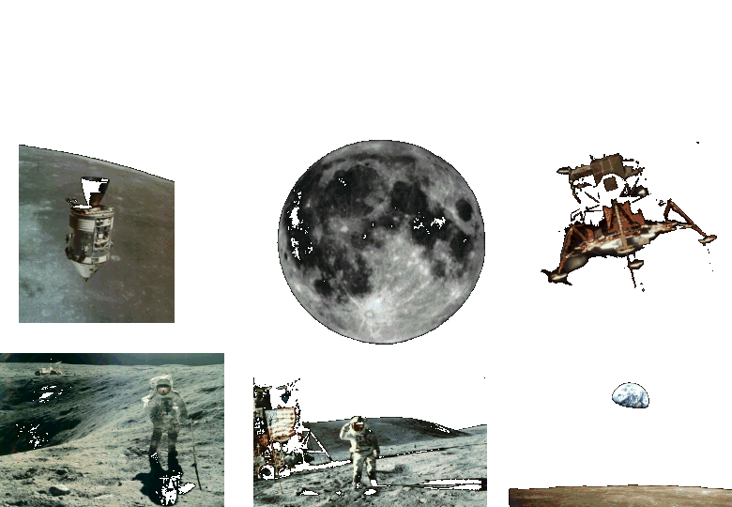
Apollo to the Moon

Slide 2
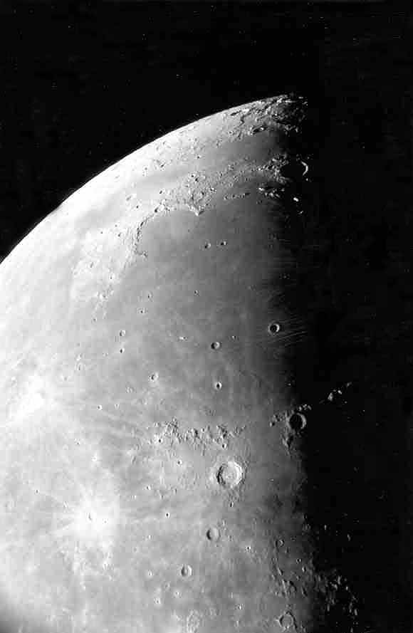
Moon maria as seen through the telescope.
Photo by Jim Fullerton

Slide 3
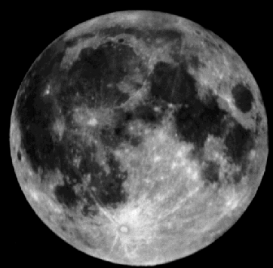
The maria (mare) are the smooth dark areas on the surface of the Moon.
Mare
Highlands

Slide 4
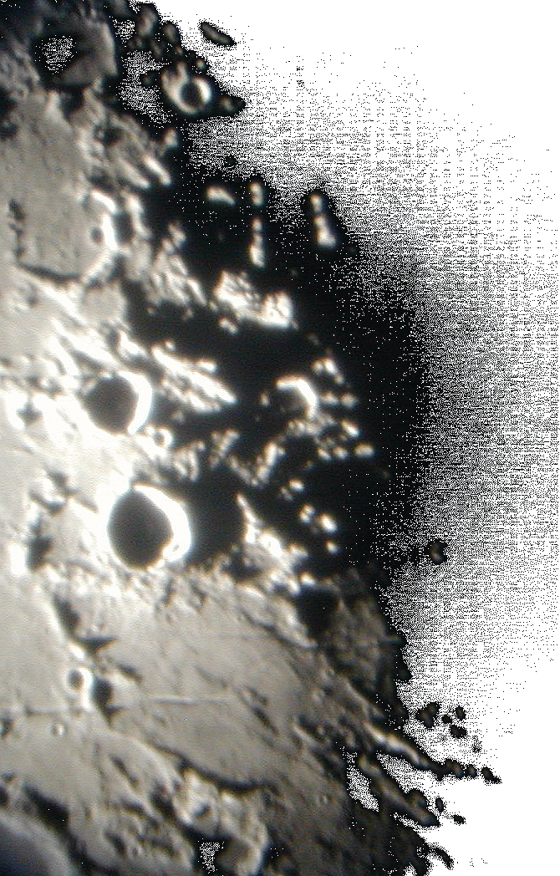
The Moon=s many craters and other features are best seen near the terminator - the line between day and night.
Photo by Lake Afton Public Observatory

Slide 5
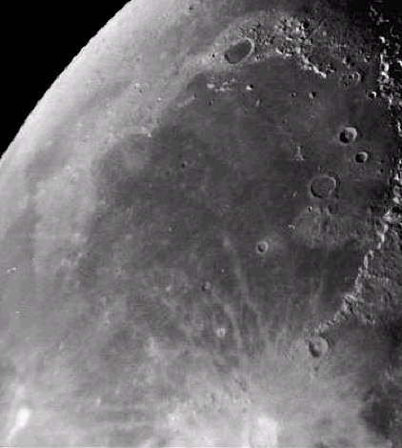
This photo shows a smooth floored lunar mare. You can easily see the ancient rim of the original impact basin.
Mare Imbrium

Slide 6
The maria were formed about 3.5 – 4 billion years ago.
Lava flowed through cracks in the lunar surface and filled in low laying areas.
Mare Imbrium

Slide 7
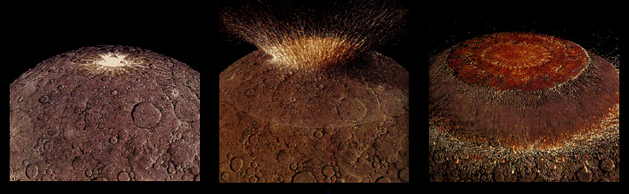
Four billion years ago the impact from a large asteroid formed a huge multi-ringed basin which then thinned and fractured the lunar crust.

Slide 8
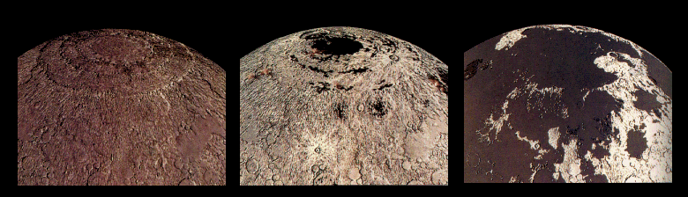
Fluid lavas from beneath the moon’s crust flowed out and flooded the low regions of the lunar surface – covering up many craters.

Slide 9
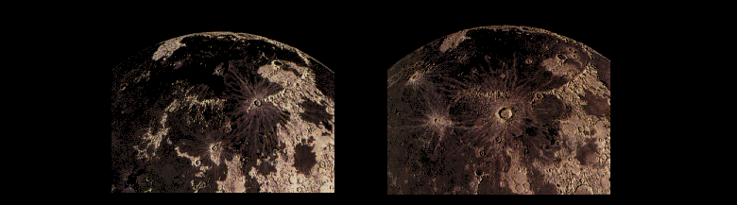
Less than a billion years after they began, the lavas ceased flowing out onto the Moons surface. However, occasionally new craters were created on top of these ancient flows.

Slide 10
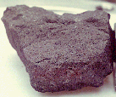
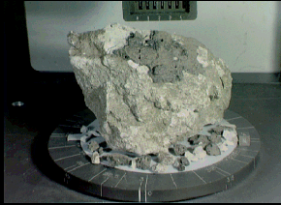
Lunar rock samples from the moon’s maria are dark colored rocks.
Samples from the highland regions are much lighter in color.

Slide 11
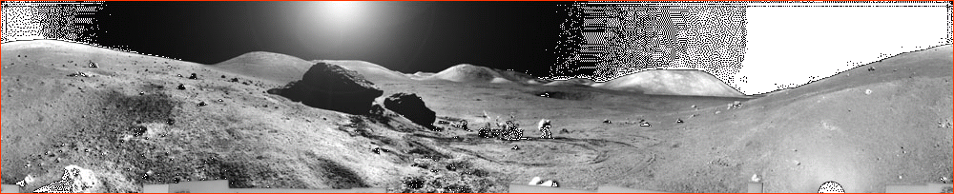
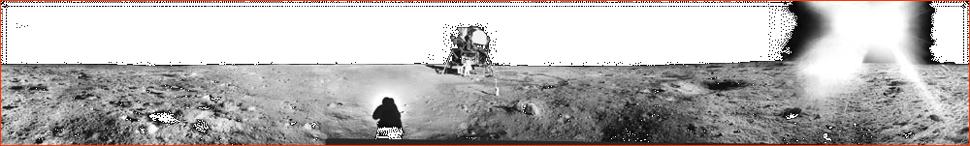
One of these shows the lunar surface from a mare and the other the highlands.
Can you tell which is which?

Slide 12
The highlands are rugged.
The mare are smooth & flat.

Slide 13
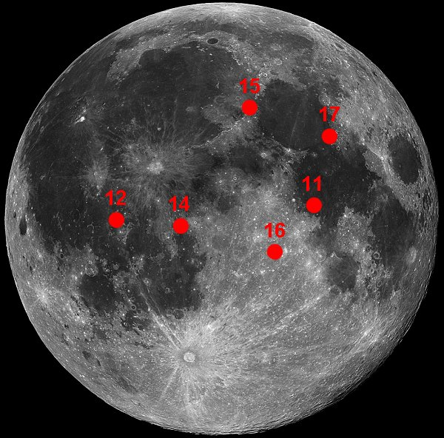
Apollo 16 Landing Site

Slide 14
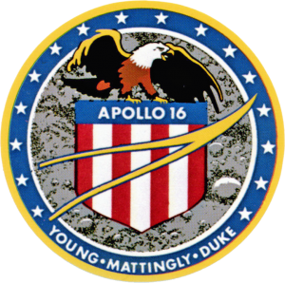
Apollo 16 –
Young, Duke & Mattingly
This was the fifth manned mission to the surface of the moon and the second mission to include a Lunar Roving Vehicle (LRV).

Slide 15
Apollo 16 –
Young, Duke & Mattingly
Apollo 16’s primary mission objective was to investigate the Descartes highlands, thought to be representative of much of the Moon’s surface. It was a type of terrain that had not been visited before.

Slide 16
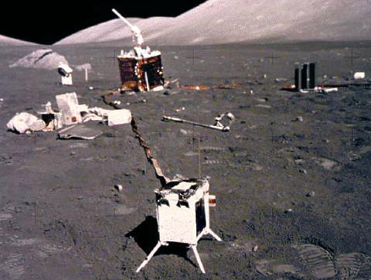
Apollo 16
On day one on the surface, they unloaded the Rover, experiments, and equipment from the Lander. They then set up the fourth of five Apollo Lunar Surface Experiment Package (ALSEP).

Slide 17
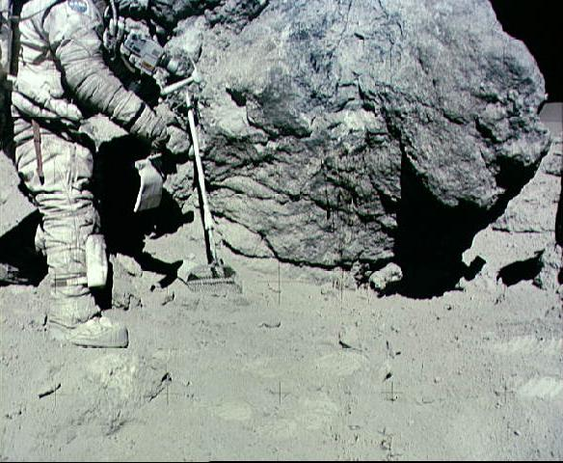
Apollo 16
Lunar samples brought back by Apollo 16, especially those from “House Rock”, disproved the theory that the area had been volcanically formed.

Slide 18
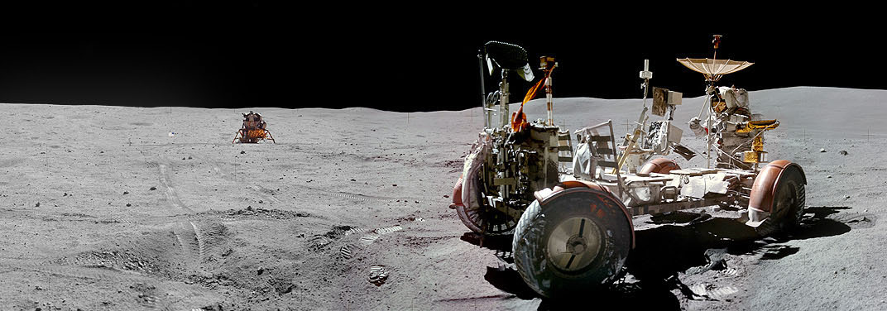
Apollo 16
During their 71 hour (nearly three full days) stay on the lunar surface, astronauts Young and Duke drove the Rover a total distance of 16.6 miles.

Slide 19
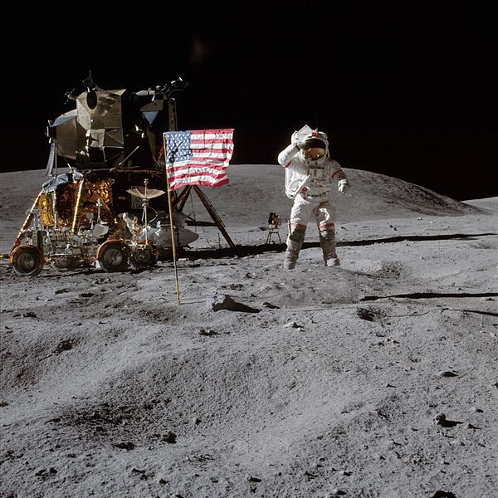
Apollo 16
Young and Duke also set a new lunar speed record of 10.6 mph and returned 209 lb of samples from the Descartes highlands.

